Slide 1


Biruni University
Computer Engineering Department
Introduction to Computer Programming
Java Lab 1
Session 3
Fall 2023 – 2024
Mahyar Teymournezhad

Slide 3
Introduction to Computer Programming
LAB SESSION 3
Exercise 1
In the realm of TVA, Miss. Minute has some problem with the conversions of the data. She now seeks your advanced programming knowledge to help to resolve the issue. While converting data she found out that there are some miscalculations. She wants you to write a program that gives a double as an input and show the missing value while casting the double into an int. Therefore you need to write a program that demonstrates precision loss when casting a double to an int. Print the original double value and the resulting int after casting and the missing value.
The input and output schema:

Slide 4
Introduction to Computer Programming
LAB SESSION 3
Exercise 1 – Answer:
import java.util.Scanner; public class Q1 { public static void main(String[] args) { // Declare a double variable with a fractional part // Print the original double value // Cast the double to an int // Print the resulting int after casting // Demonstrating the precision loss } }

Slide 5

Introduction to Computer Programming
LAB SESSION 3
Exercise 2
While Miss. Minute fixed the issue with the data loss, she found out that the system can not handle Infinity!
Your job is to create a program and show the possibility of having Infinity without getting the divided by zero exception!
Seems hard but in fact it’s just a simple line of code!
At the same time we need a value for that Infinity to define it in the system.
Hint:
Use Math.round()
$$∞\sim \frac{r}{0} \left| r:real number\right.$$

Slide 6
Introduction to Computer Programming
LAB SESSION 3
Exercise 2 – Answer:
public class Q2 { public static void main(String[] args) { // Write your code here
… } }

Slide 7
Introduction to Computer Programming
LAB SESSION 3
Exercise 3
The whole TVA system is working like 80’s computer system. Has some problem with the storing string and characters. Miss. Minute asks you to write a program that converts your name to integer. For example if your name is Efe, your integer value of the name is: 69102101
E: 69, f: 102, e:101

Slide 8
Introduction to Computer Programming
LAB SESSION 3
Exercise 3 – Answer:
public class Q3 { public static void main(String[] args) { // Write your code here } }

Slide 9
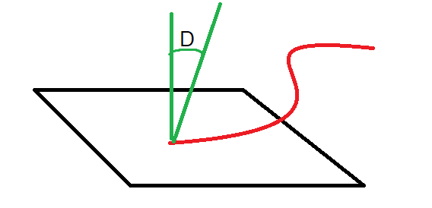
Introduction to Computer Programming
LAB SESSION 3
Exercise 4
We have a device in TVA that absorbs the energy from the time strings floating in the air! We need to find the maximum energy absorbed by the device. Each time string hit the panel of the device in a certain angle. The formula for the energy is:
The L is the length of the String, the D is the degree of the string with the panel.
The input of the program is going to be a single line of 2 doubles, First going to be the length(L) and the second is going to be the degree(D).
Careful: You have to change the D to radiant
Your output should be a single number of maximum Energy!

Slide 10
Introduction to Computer Programming
LAB SESSION 3
Exercise 4 – Answer:
import java.util.Scanner; public class Q4 { public static void main(String[] args) {
// Write your code here
….. } }

Slide 11


